Slide 2
Today’s Agenda
Introduce ourselves
Provide an overview of Hooper Corporation
Explain this acquisition
Answer your questions

Slide 3
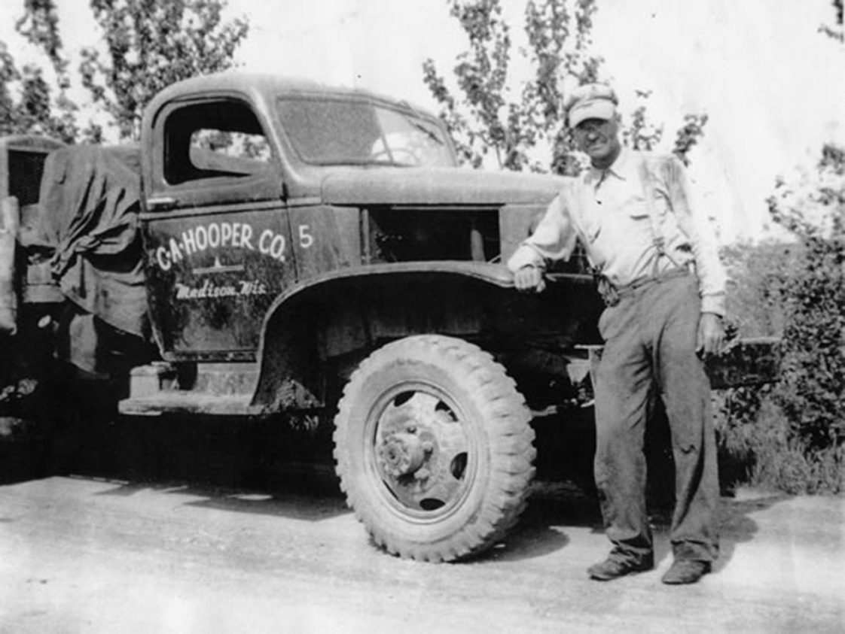
About Hooper
Established in 1913 as a local Madison, WI company
Over 100 years old
Annual Revenue in Excess
of $200 Million
Closely held Management
Owned Corporation
Employs 600-700

Slide 4
Hooper Corporation
Electrical Power
Transmission
Substation
Distribution (OH & UG)
Line Clearance
Mechanical
Plumbing
Power/Process Piping
Fire Protection
HVAC
General Heating & Air Conditioning
(A Hooper Corporation Company)

Slide 5
Why this acquisition
Creates diversification of HC into gas markets and Premier into electric markets
Provides resources to help Premier grow and better serve customer base
HC Infrastructure (Fleet, IT, HR & Safety) allows Premier focus on its operations
Grow gas/electric services to existing customers
We are hiring and investing in the business!

Slide 6
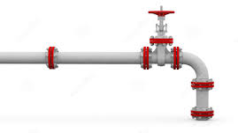
Acquisition creates a more diversified company to provide electric and natural gas services to energy delivery customers

Slide 7
Our customers want this partnership
Premier customers want additional capabilities/resources
Hooper customers want natural gas services
Premier customers want electric services
Notes:
Tell personal story about interactions with a customer about the need to integrate services. Focus on meeting the customer needs and our value proposition

Slide 8
Hooper and Premier synergy
HC/Premier are aligned by our guiding principles:
Safety is our No. 1 core value
We conduct business the right way… with honesty and integrity
We pursue excellence
We build strong and lasting customer relationships
Notes:
Both Hooper and Premier share a common commitment to safety, quality, responsiveness, and cost, to build and maintain the infrastructure that enables energy utilities to confidently deliver cost effective, reliable and efficient power to homes and businesses throughout the US.”

Slide 9
The Hooper commitment to Premier
What stays the same
John Stenger, President
Benefits/Pay/Reporting Structure/Service Dates
Premier offices in Dayton and Cinn.
Email addresses
What changes
Premier becomes a Hooper Corporation Company
John reports to Steve Lindley, head of the Electric Power Division
Back office infrastructure integration, where it makes sense
Capital infusion to help Premier meet customer expectation service levels
Notes:
Even though Premier will operated as a business of Hooper, we will look to integrate parts of the business and operations that make sense. The integration will be focused on identifying and creating efficiencies between the two businesses… not eliminating costs and jobs. The people of Premier are its strongest asset so we want to help create an environment that facilities a customer centric culture and success.

Slide 10
Our objective is to invest and grow
Premier and the natural gas business
Services synergy
Value the Premier team
Smart growth strategy
Continue to build a customer centric culture
Notes:
Hooper acquired Premier because it sees a synergy of services and a tremendous opportunity to grow both businesses. The energy delivery utilities want more integrated and quality partners who can work with both electric and natural gas. We anticipate both companies to grow in the coming years.

Slide 11
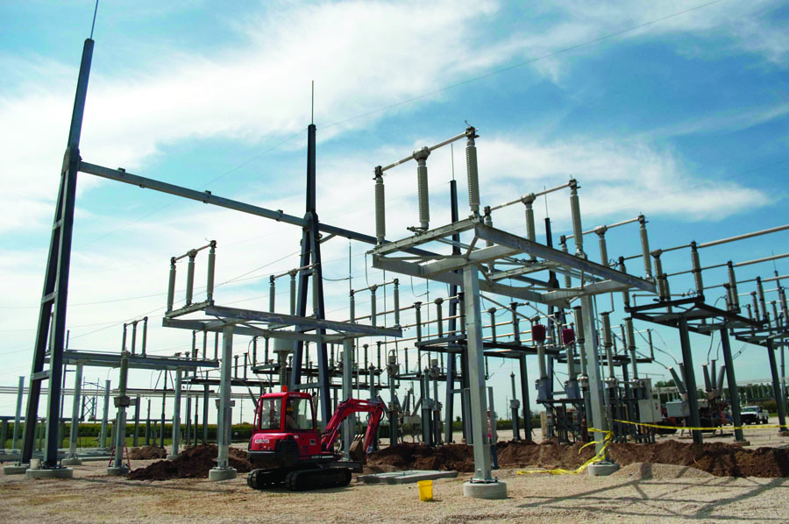
Electric Power Division Services
Overhead and Underground Distribution Construction and Maintenance
Overhead Transmission Construction and Maintenance
Substation Construction and Maintenance
Line Clearance Services
Storm Restoration Services
Renewable Energy Construction

Slide 12
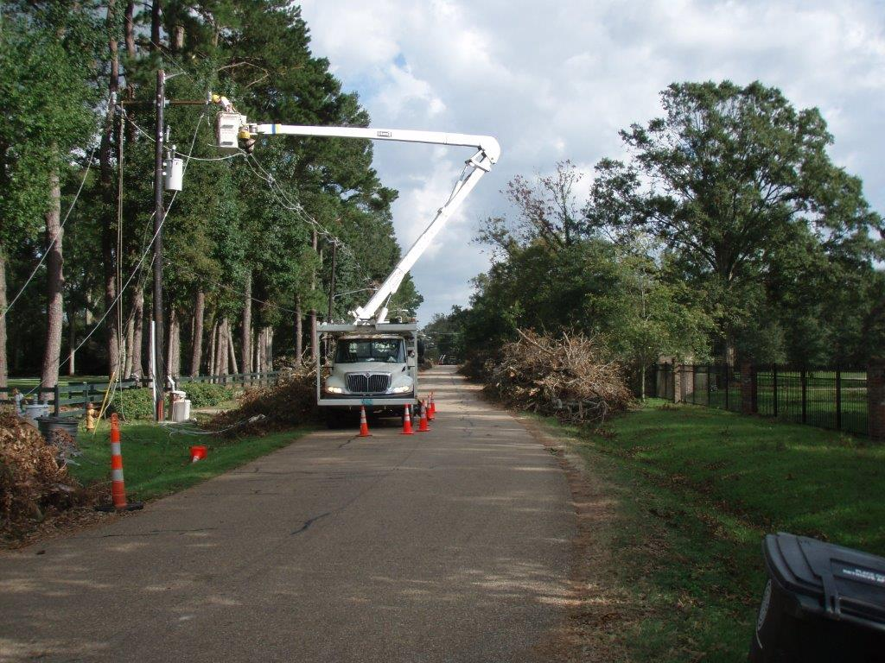
Electric Power Division Overview
Corporate Office – Madison, WI
Regional Electric Power Division Offices
Davie, FL
Livonia (Detroit), MI
Denver, CO
Team
Safety
Executive
Project Management
Fleet

Slide 13
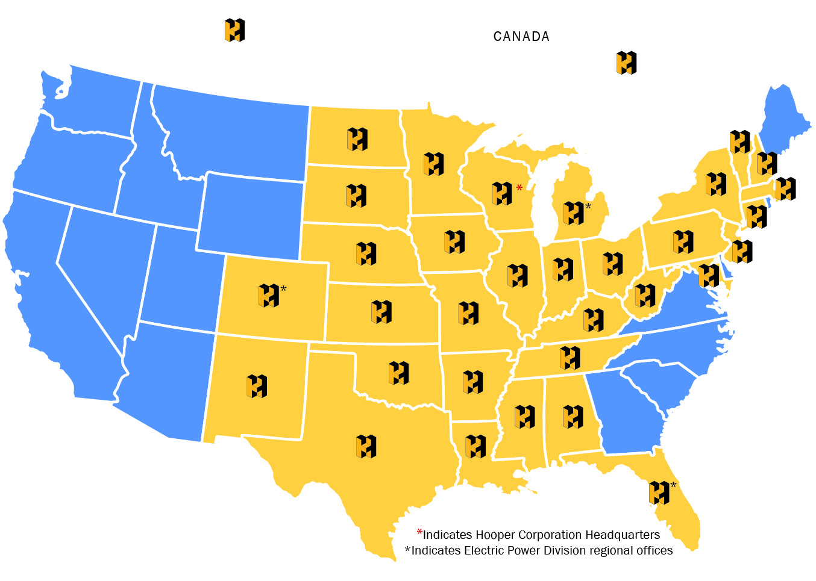
Where We Work

Slide 14
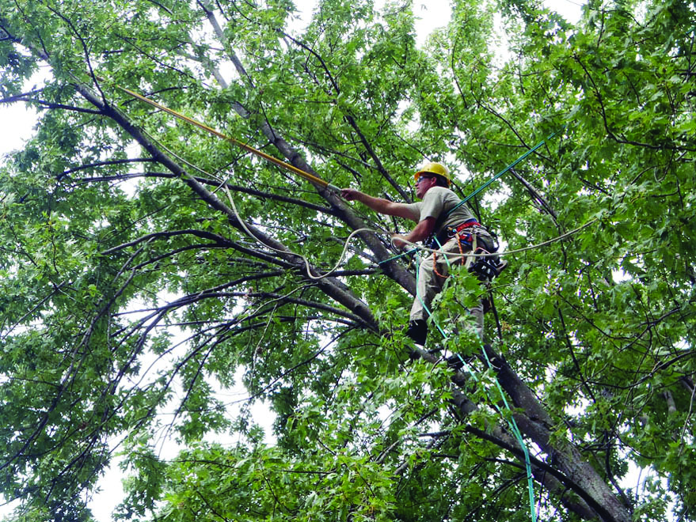
Relevant Project History
Madison Gas and Electric Distribution and Substation Construction and Maintenance
Madison Gas and Electric Line Clearance
Xcel Energy Distribution
Construction and Maintenance
WE Energies Substation
Construction and Maintenance
WE Energies Overhead
Distribution Construction
and Maintenance

Slide 15
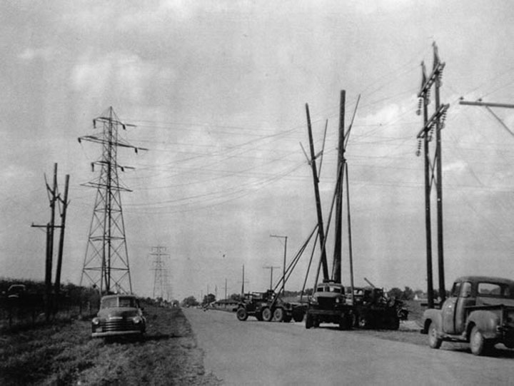
Our Guiding Principals
Keep safety as our first priority
Safety is part of every employee’s individual responsibility whether they are a field trainee or in upper management.
Do business the right way
Conducting business with honesty and integrity has built Hooper’s credibility and respected character in the industries we serve.
Pursue excellence
It is our goal to exceed expectations and pursue excellence in every aspect of every project, whether that be in safety, production levels, or any other measurement.

Slide 16
Our Guiding Principals (cont.)
Build strong customer relationships
It is our goal to develop lasting customer relationships and pursue partnerships within the industries we serve.
Emphasize environmental stewardship
Our environmental protection goals are achieved by effectively balancing project objectives with sound environmental protection measures.
Lead with corporate citizenship
Through the Hooper Foundation we support many local charities and encourage all employees to give back to the community through our Matching Gift program.

Slide 17
Our Guiding Principals (cont.)
Embrace our industries’ futures while respecting our company’s roots
It is our philosophy to honor where we came from and to use the knowledge gained from our extensive experience to improve our industries’ futures.

Slide 18
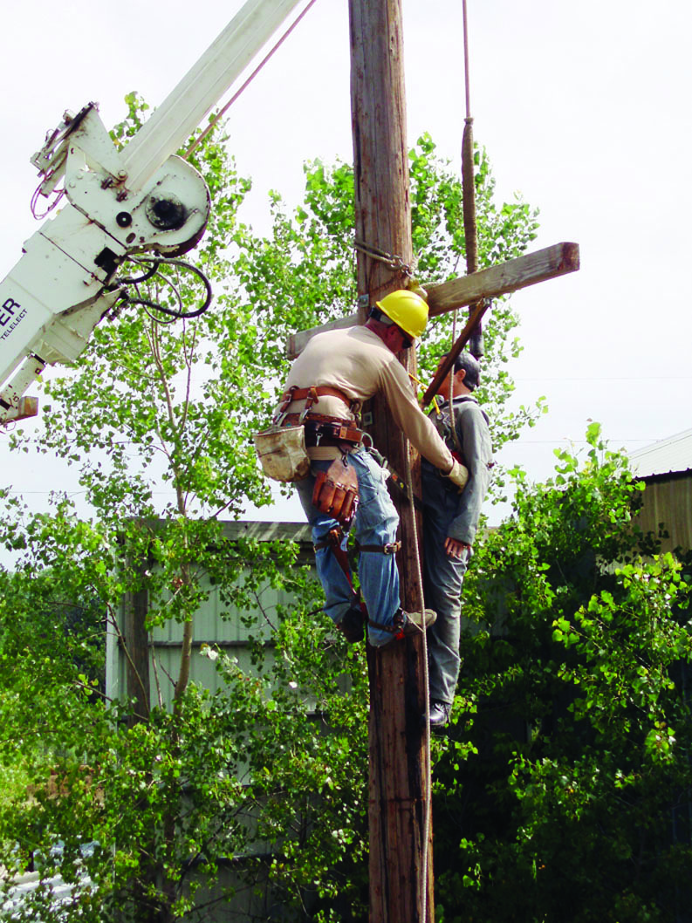
Safety
Our Most Important Core Value
Industry Leading Program
Dedicated to continuous
improvement
Professional staff of 9 with the
Manager reporting directly to
the President of the Company
Focus on Training and Education,
Project Support
Effective Presence on Site

Slide 19
Customer Service
Long Term Relationships with our customers
We are on the front line and are the face of our customers, with their customers
We are continually measured on our performance.
We are committed to being an integral part of the communities that we work in.

Slide 20
Questions?

